Slide 1

Helper Guide Robot
That might change the world for disabled or will make our travel more effortless

Slide 2
Contents Of My Presentation
Here’s what I will talk about in this ppt:
Creation of the 3d modelling
Choosing which platform to use for 3d
Technology of the Helper robots
Innovation of the Guide robots and how it might change the way we travel completely

Slide 3
Introduction
-What kind of Robot it will be and why specifically this type…
- What shape we should choose for best experience …

Slide 4
To make our lives easier
Making disabled people’s life easier
Making our travels more fun

Slide 5



The best platform to choose for 3D

Slide 6
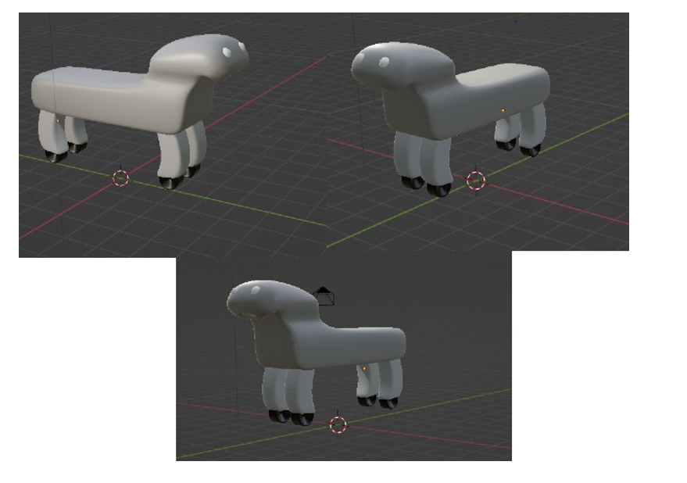
3D Modelling (using Blender )

Slide 7
Technology & Innovation
We will try to make our robots help users to find their way around unknown environments, for instance guiding them to a specific location or sharing important information with them
Our Robot will be designed to assist humans in malls, airports, health care facilities, home environments and various other settings.

Slide 8
Technology & Innovation
Guider
Carrier
It will tell you where to go or tell the direction so you can follow
It will carry your belongings
Reminder
Friend
Reminds important things like flight time , medicine time
It can talk to you in real time

Slide 9

Thank you!
Do you have any questions?
elbekjonyusupov0303@gmail.com
Yusupov Elbek
12194909

